Slide 1

DRESS LIKE AN EGYPTIAN

Slide 2

ABOUT FARIDA TEMRAZ
Farida Temraz, started her Haute Couture fashion design at the age of 21.
She named her brand "Temraza".

Slide 3

PARIS FASHION WEEK
Last year she won First Place at the Paris Fashion Week. More than 3 movie stars wore her dresses at the last Oscars.

Slide 4

NEW YORK FASHION WEEK
Farida is taking part in the upcoming New York Fashion Week September 11-14 and, as Farida’s Marketing Team, we are helping her promote herself. Her theme is "Rise of the Pharaohs" and she will use pharaonic makeup and colors for her models.

Slide 5

PROMOTE EGYPT THROUGH FARIDA’S EXPOSURE ABROAD
As Egypt has been going through a lot of turmoil over the past 4 years, we thought we could use this event to get global attention and to attract people to our country.
We have spoken to a lot of top people from the private sector and civil society and they are all eager to contribute.
We would love to work with the Government and Public Sector to promote Egypt through Farida’s exposure abroad.

Slide 6
DRESS LIKE AN EGYPTIAN
We thought of an audio-visual message that involves Egyptian World Leaders in their different fields. They include:
Ahmed Gabr. Two time Guiness Record Holder in Deep Sea Diving.
World Champions of Squash Tournament this year.
Top world Cardiologist. Honored by the Queen of England.
Farouk El Baz Top Egyptian who helped the US go to the Moon.
Top Egyptologist known as the Indiana Jones of Egypt. Top singer (My daughter Rula Zaki) who sings in 14 languages and is known as "The Human Trumpet" and finally top Haute Couture Designer.

Slide 7
DRESS LIKE AN EGYPTIAN
Something like this:
"Dive like an Egyptian”
“Play Squash Like an Egyptian”
“Save a Heart Like an Egyptian”
“Help take the World to the Moon Like An Egyptian”
“Discover Ancient Egypt like an Egyptian”
“Sing Like An Egyptian”
“Dress Like An Egyptian” Farida Temraz.

Slide 8

RISE OF THE PHARAOHS
The theme of her dresses is called: "Rise of the Pharaohs" and she will use Ancient Egyptian cosmetics colors. So our Art Director will use the Pharaonic "eye" as the dot on the "I" of "Rise".
We would love to get maximum exposure for Egypt and Farida before and after the event. We would love to include an event in New York, under the auspices of our embassy with Rula Singing New York. New York and doing her trumpet. Here is the song.

Slide 9

KEYNOTE SPEAKER IN COPENHAGEN
Farida is also invited as a Keynote Speaker in Copenhagen in October at the Annual Meeting of a Global Communications Company, ComVort , with 180 0ffices around the world.

Slide 10
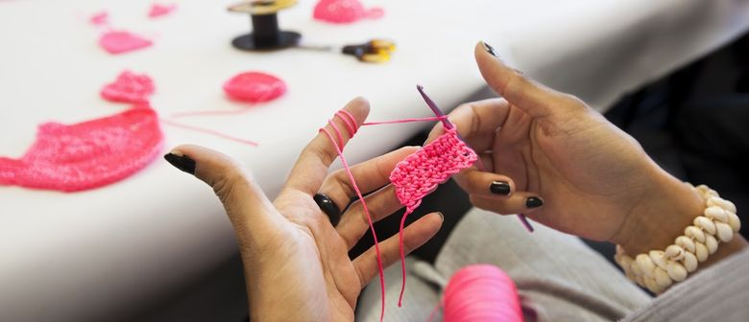
TEMRAZA CSR PROGRAM
Farida is initiating a Corporate Social Responsibility Program, Where she is approaching Private Sector and Government to create jobs for people with limited income in the various governorates to produce her accessories.
For example doing crochet for her fashion wear. It is noteworthy that Temraza Fashion Wear is being sold in Paris and London.

Slide 11
FIRST EGYPTIAN GLOBAL FASHION BRAND
Temraza has participated with a package of $10,000 in this event. Temraza will be the first ever Egyptian brand to showcase in NYFW in the history of fashion.
Farida will be staying for 20 days in NY. In addition, Temraza also has been offered a top fashion magazine a placement of a photoshoot for this collection as an inspiration of the Egyptian culture. Farida would love to be part of public diplomacy globally to promote her country Egypt.

Slide 12
APPRECIATE YOUR KIND SUPPORT
We would appreciate your kind support in the following:
Free EgyptAir tickets New York and Copenhagen return.
Accommodation in New York
Production of Video Message. “Dress Like An Egyptian”
Permits for photoshoots at Touristic Sites.
Pre and Post Media Support.
Pre or Post PR event supported by embassy in U.S.

Slide 13

WHAT’S IN IT FOR EGYPT
This campaign could serve to attract global attention to boost Tourism in Egypt.
Showing Egyptian celebrities as affecting different fields globally, would dispel the bad publicity that Egypt has been receiving over the past years.
This would encourage exports of Quality Egyptian products.
EgyptAir Official Carrier Publicity would get good exposure as sponsoring Temraza.
Corporate Social Responsibility and Job Creation.

Slide 14
Thank you!

